Slide 1

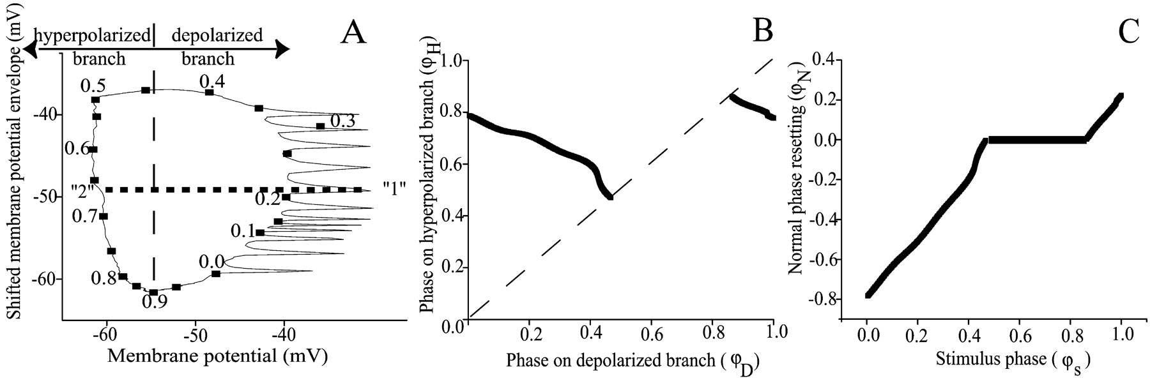
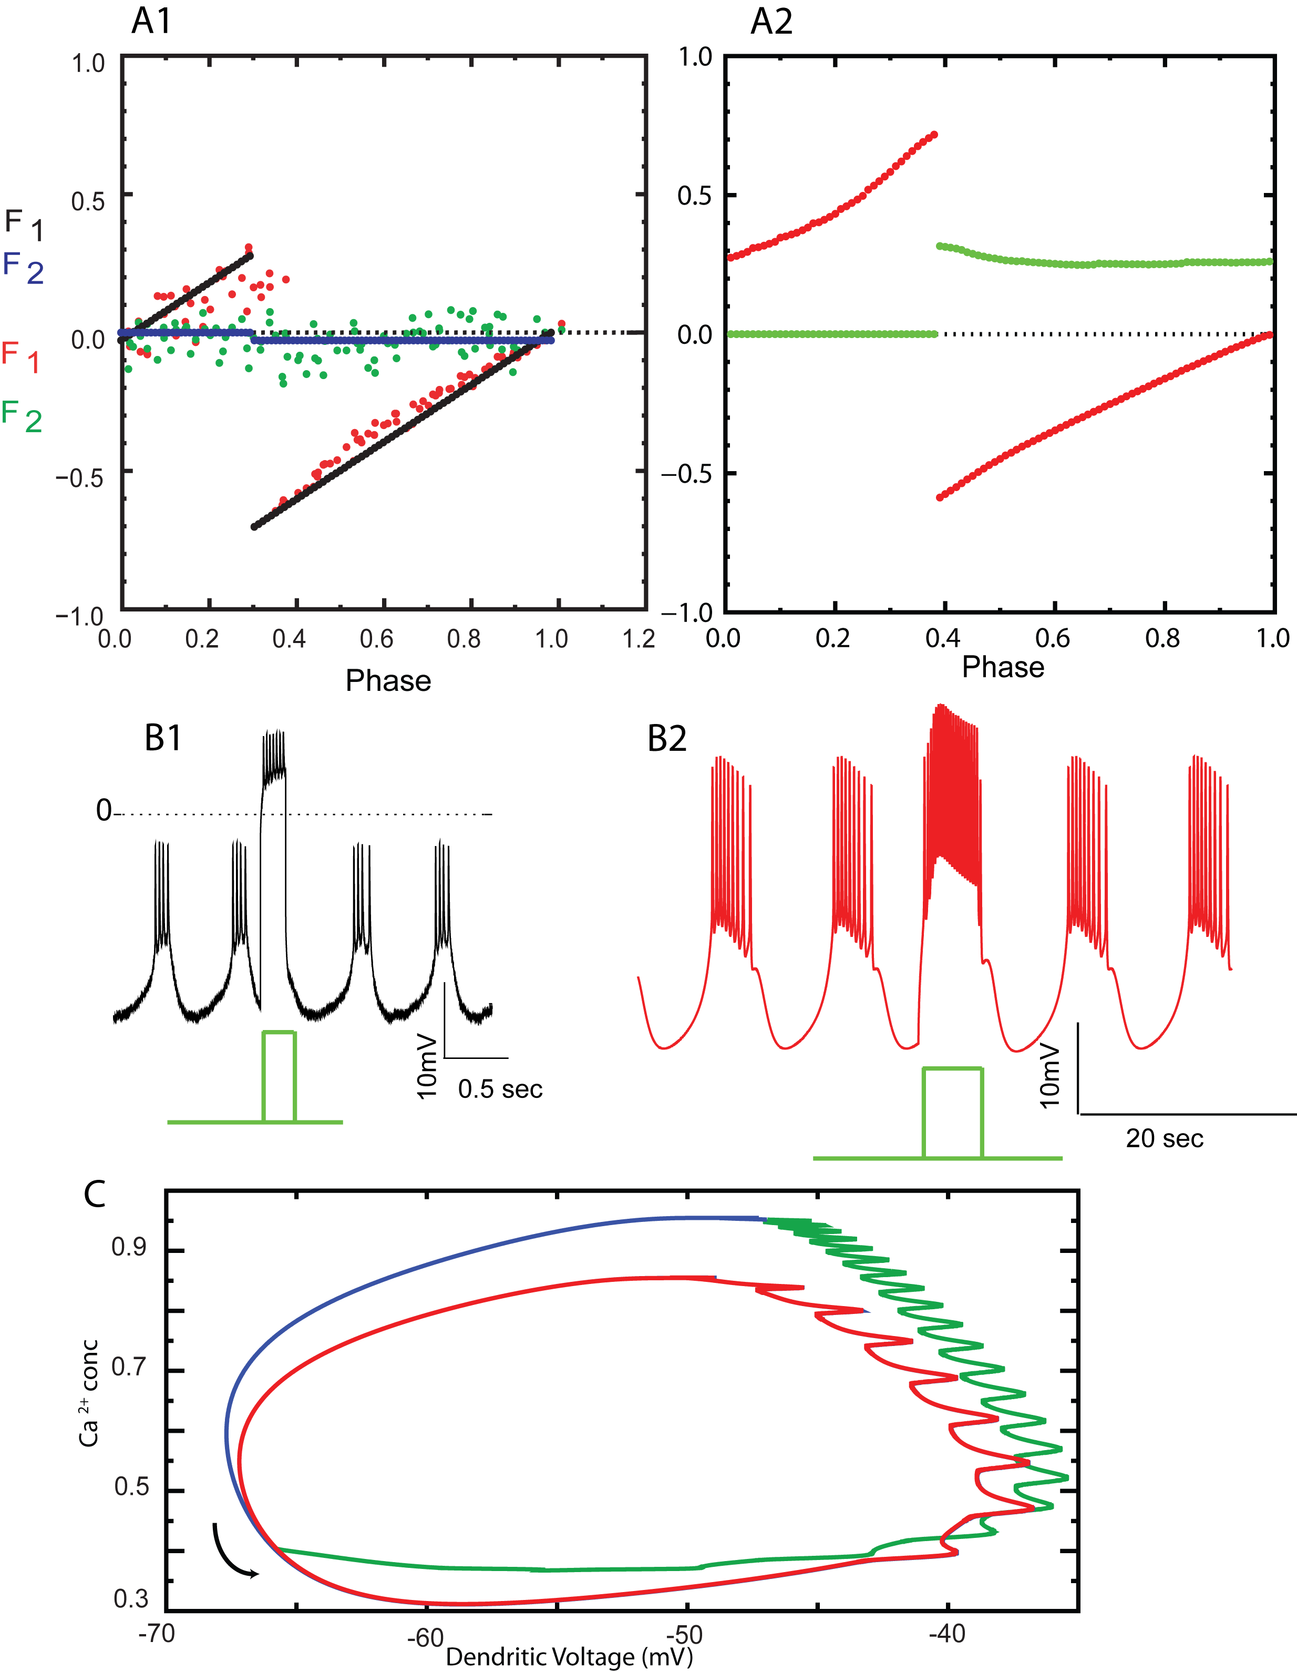
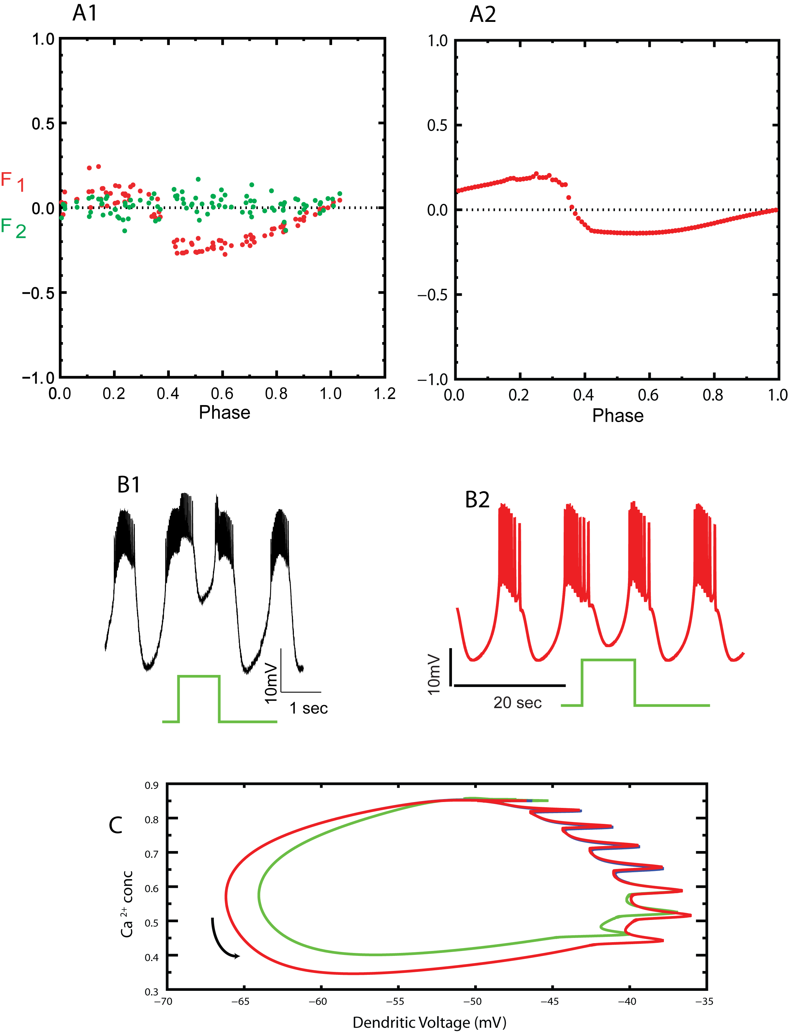
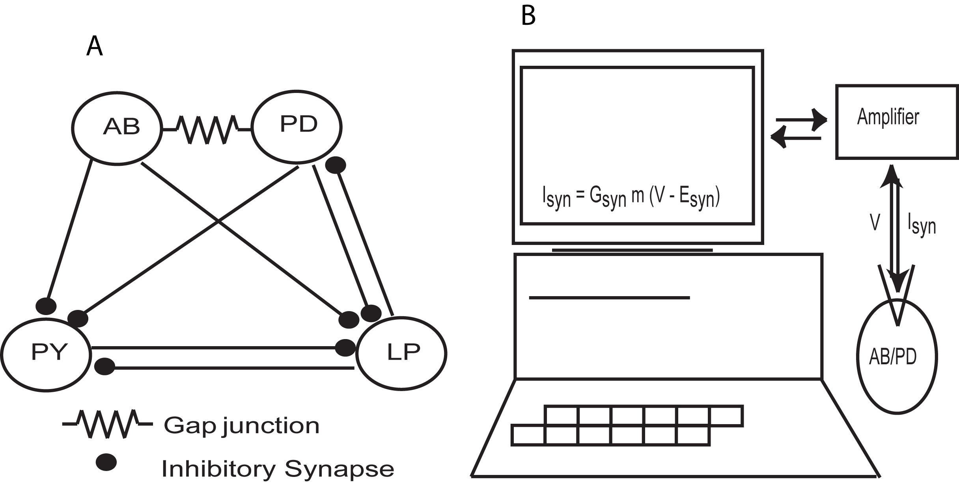
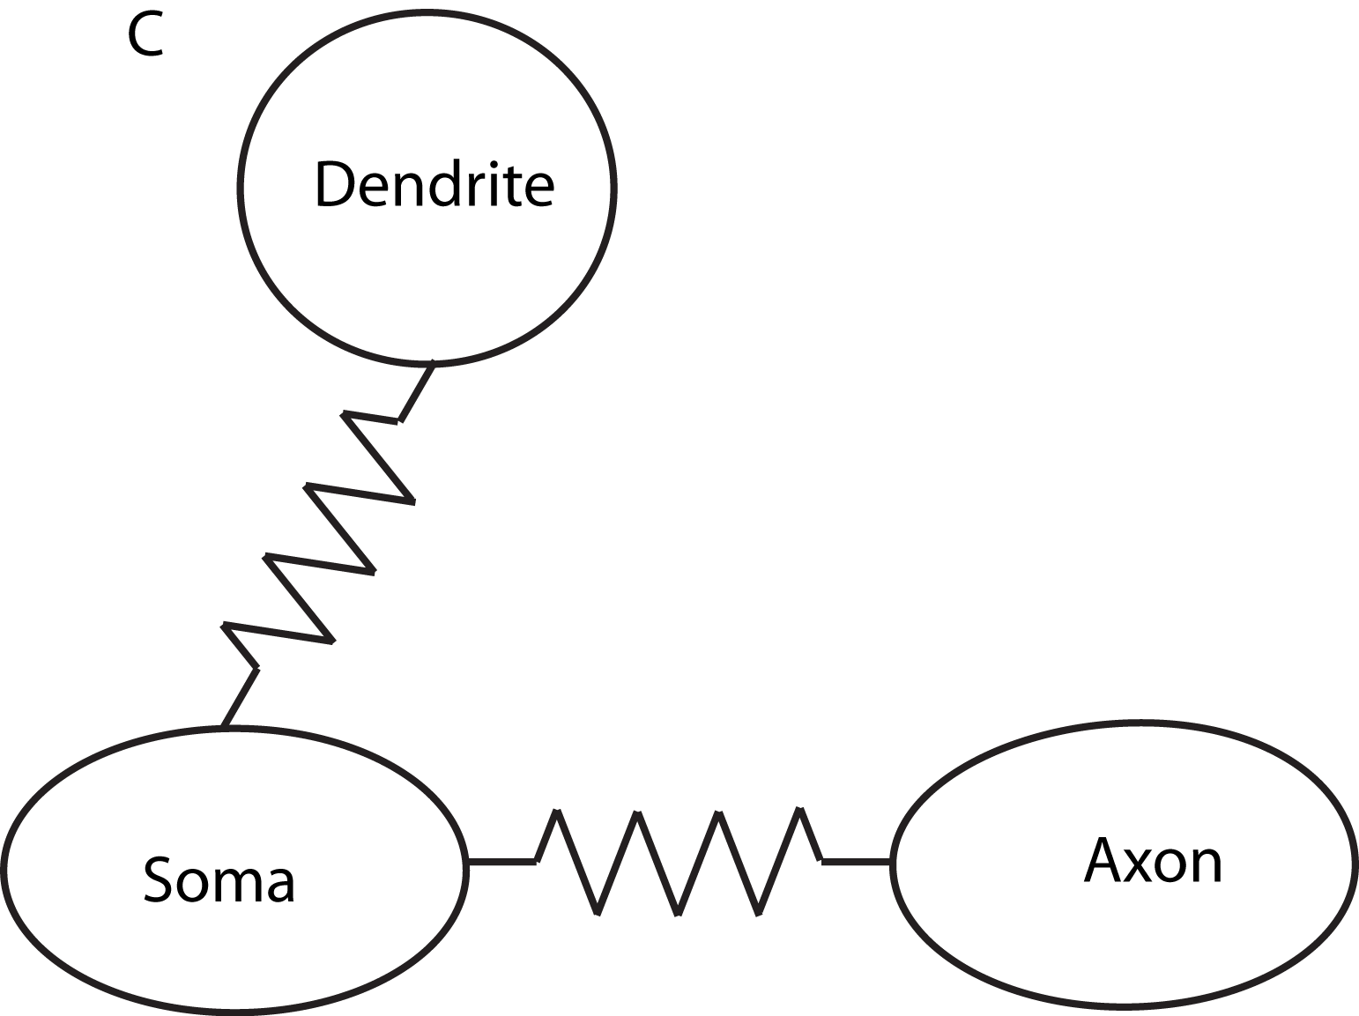
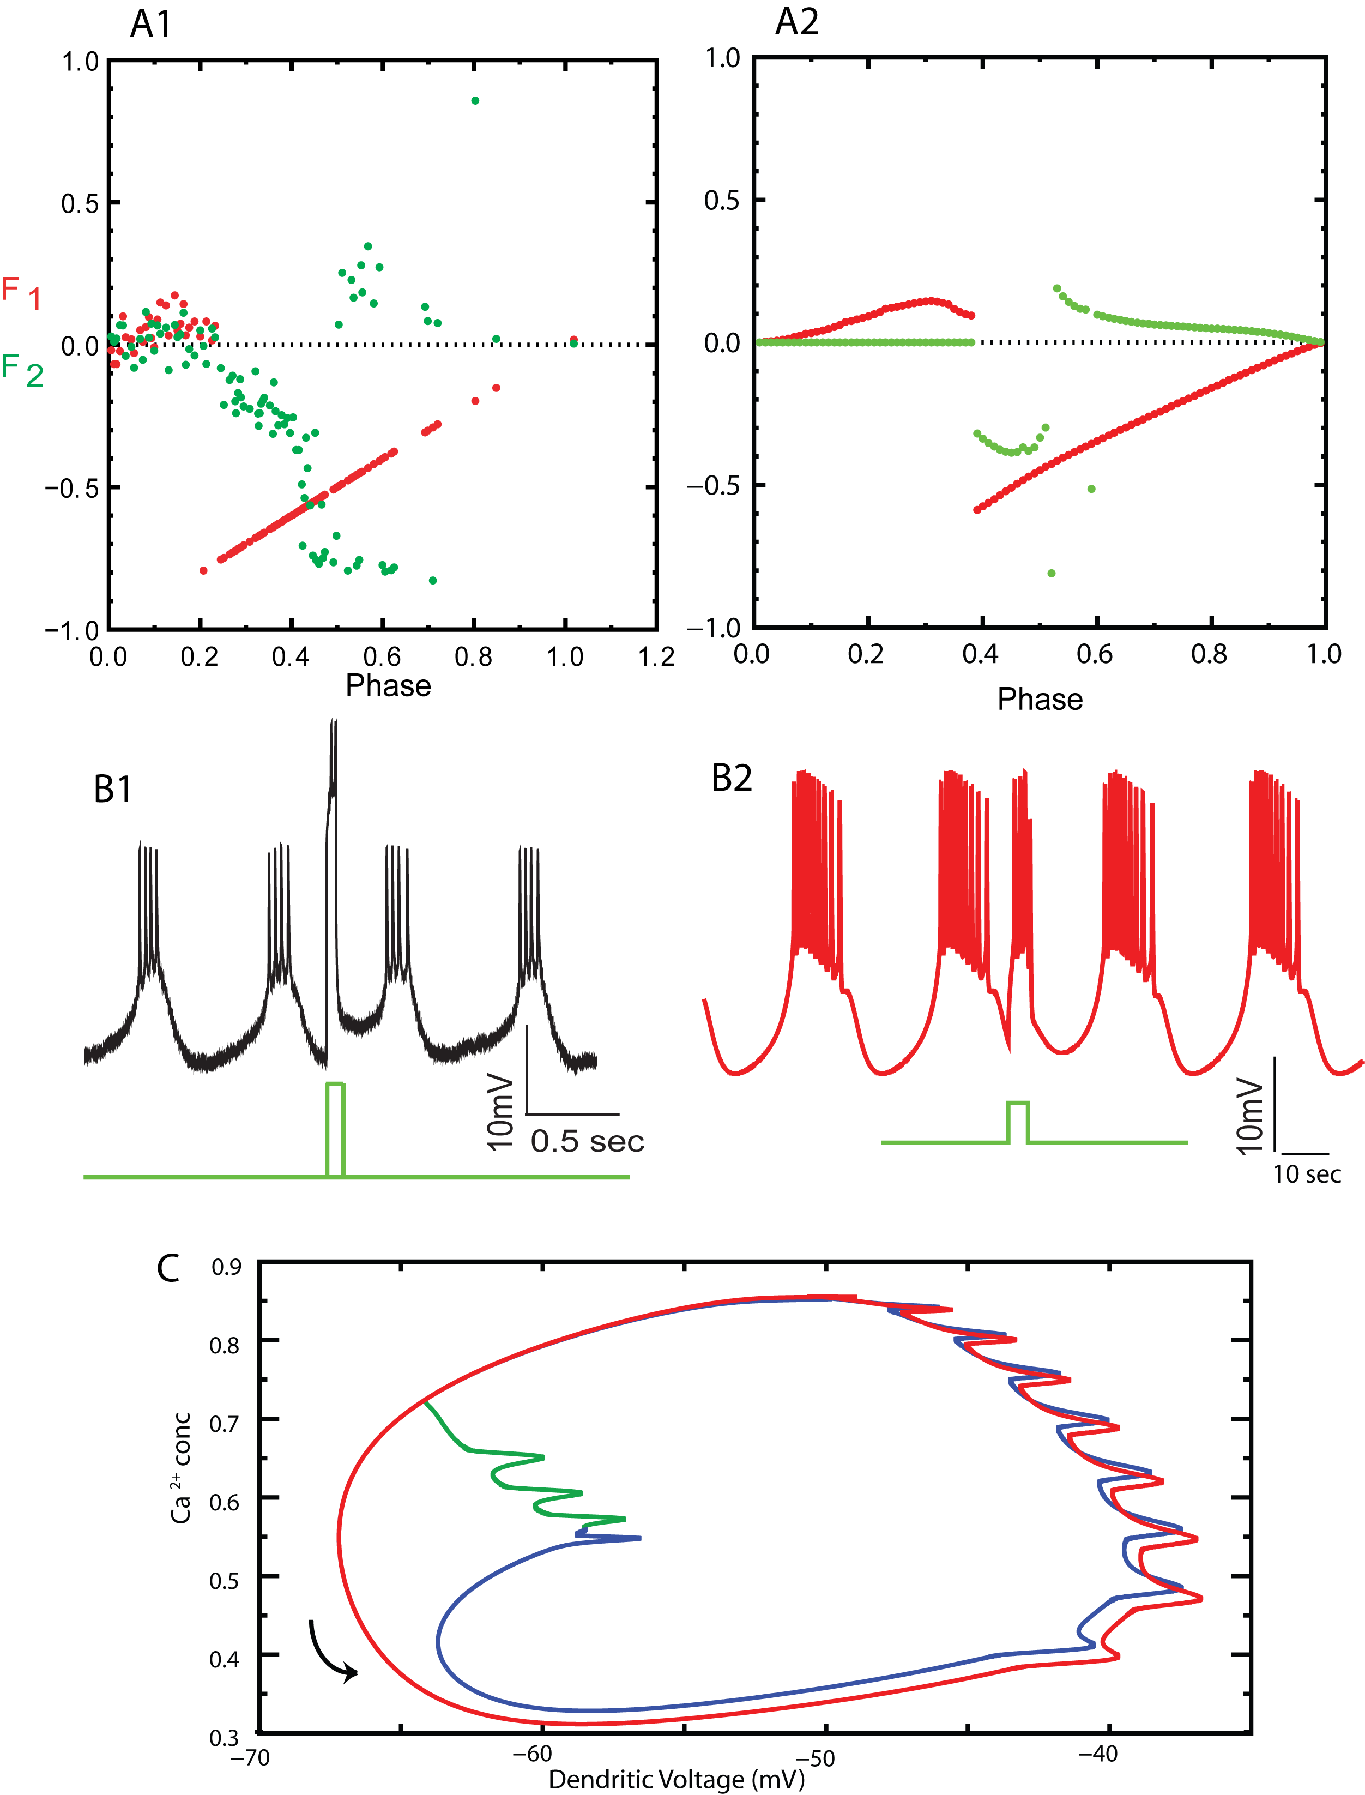
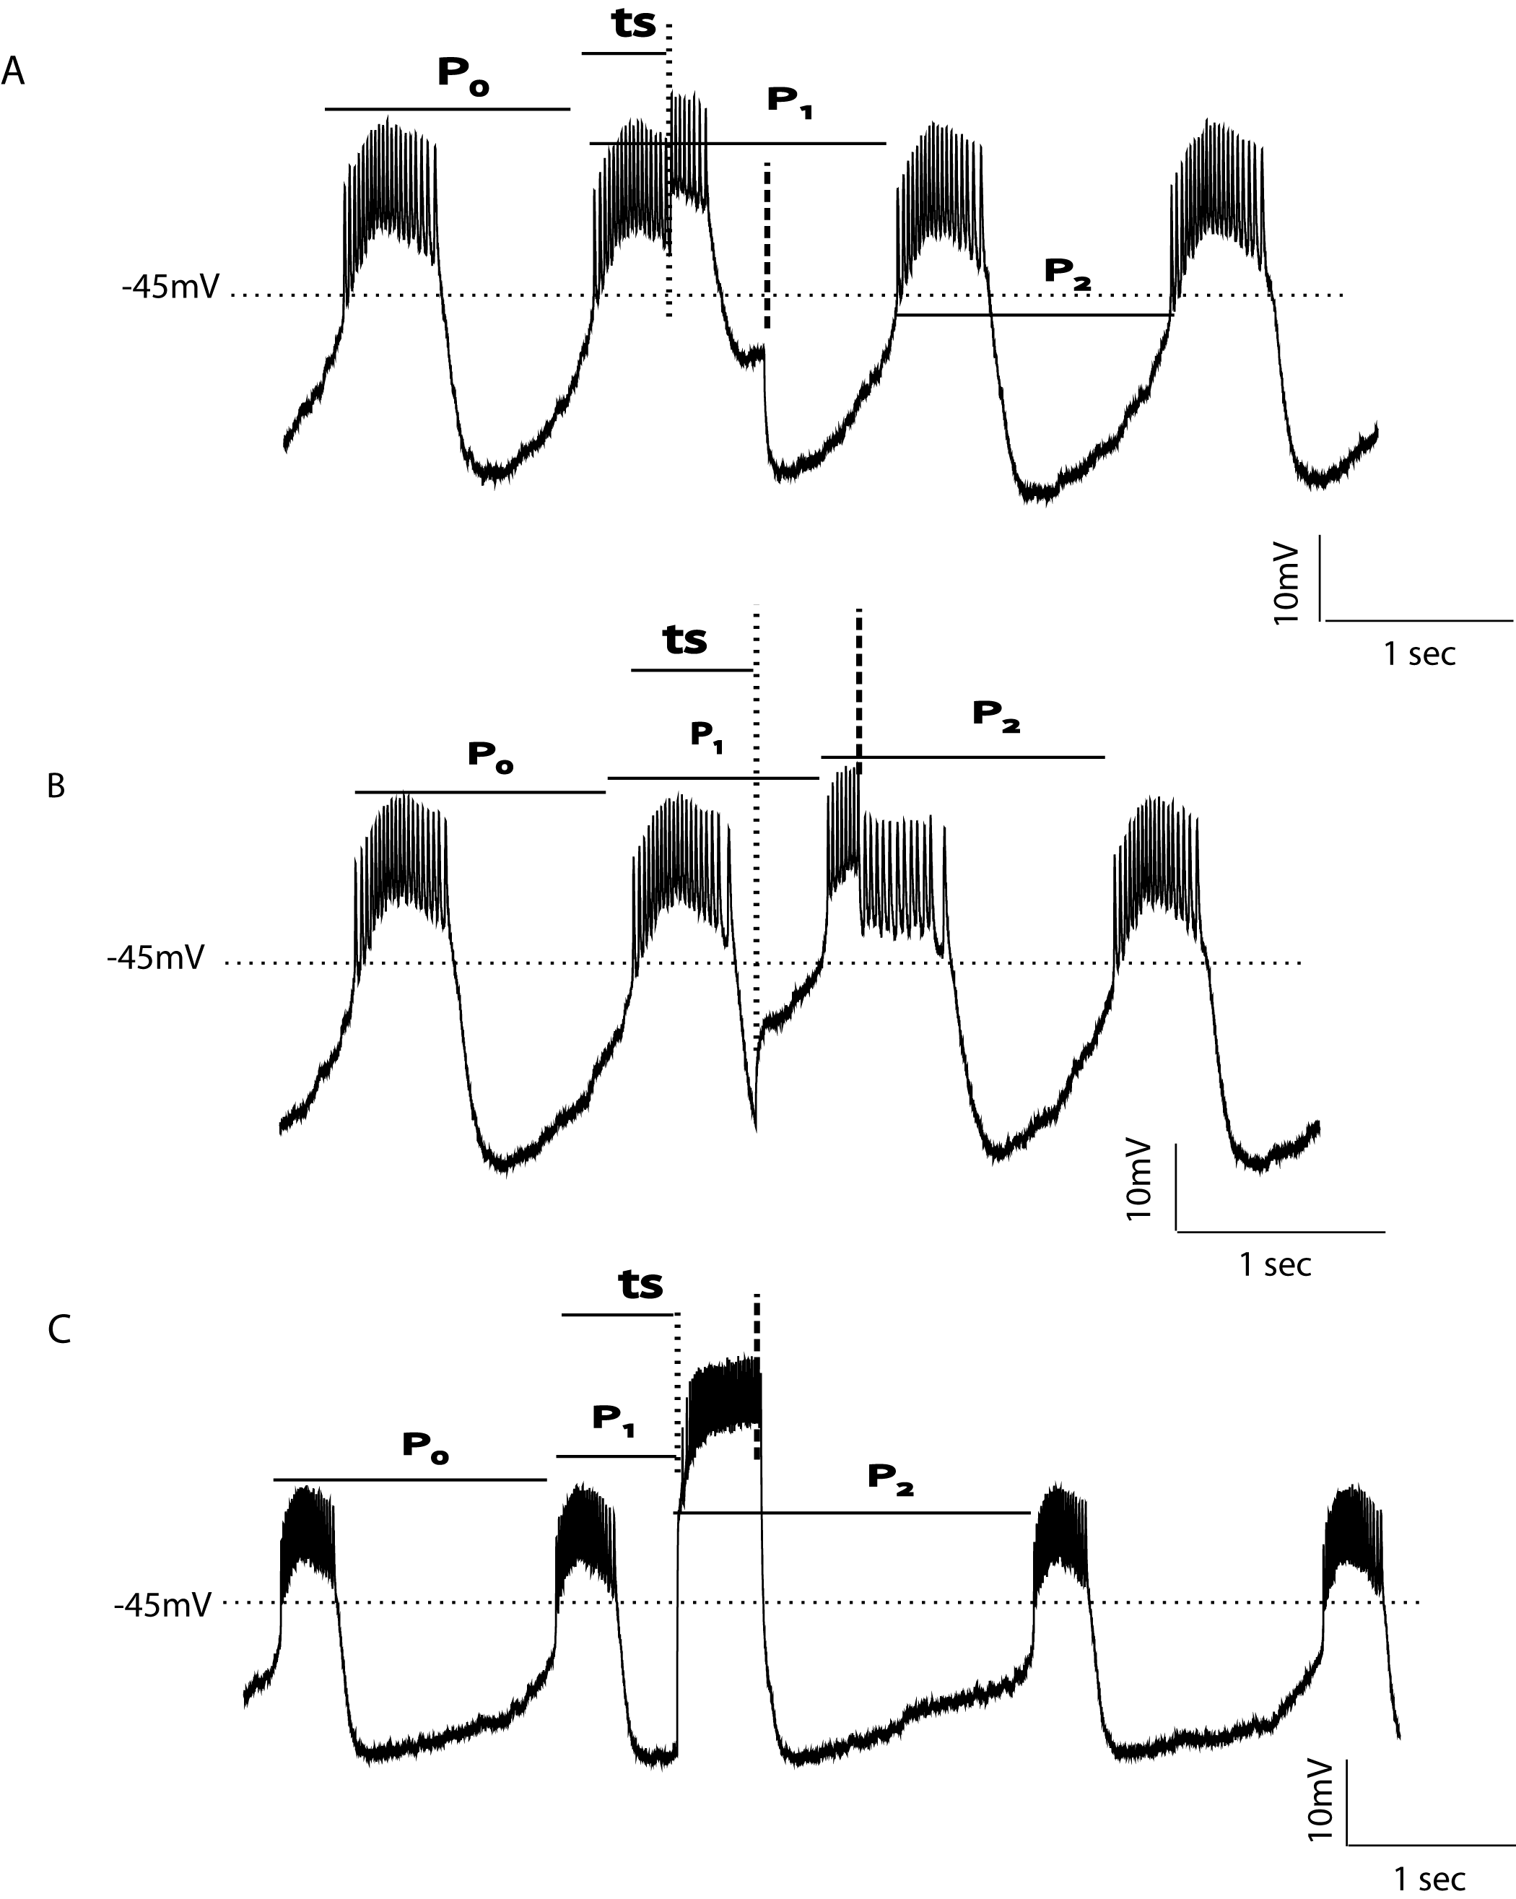
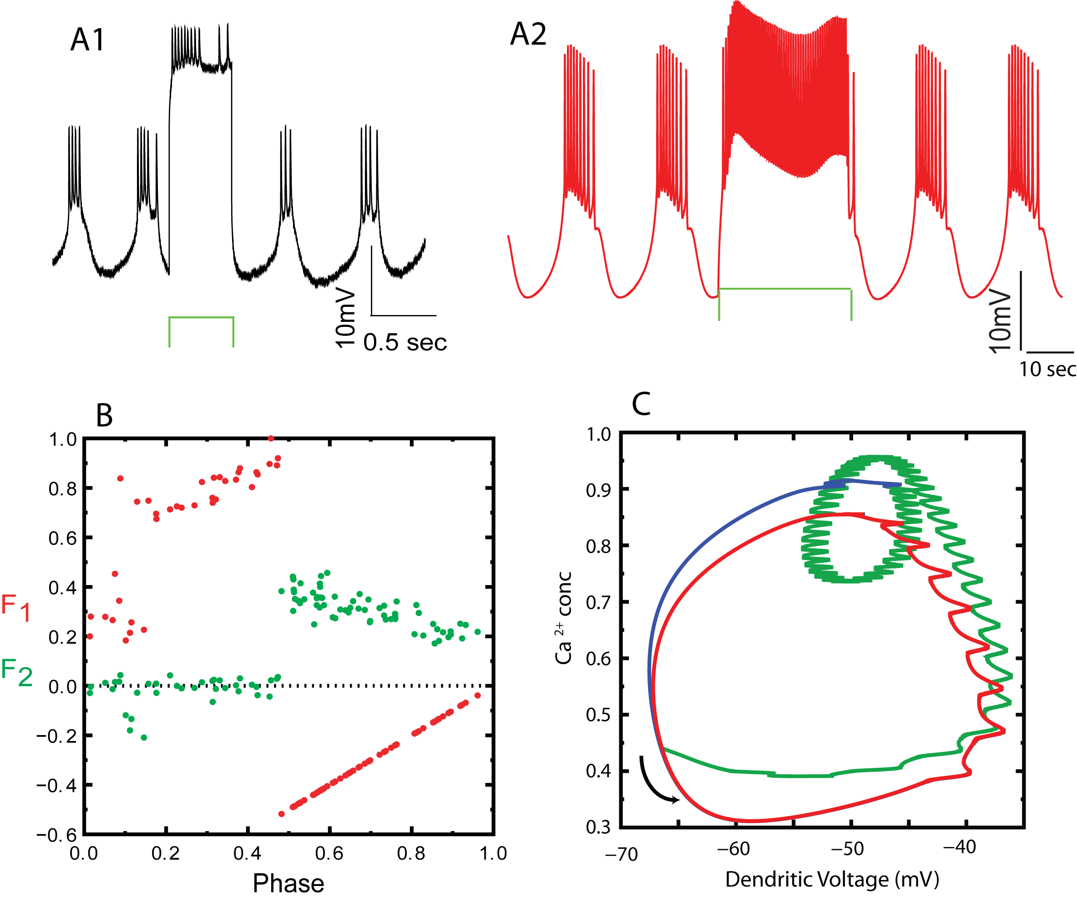
Phenomenology of Phase Resetting in a Bursting Neuron in Response to Excitation
Selva K. Maran¹, K.Demla², F.Sieling³, A.A.Prinz^{2,3} and C.C. Canavier¹
¹Neuroscience Center of Excellence, LSUHSC, New Orleans, ²Biology Dept, Emory University, Atlanta, ³Wallace H. Coulter Department of Biomedical Engineering, Georgia Tech and Emory University.
Introduction
Phase resetting curve (PRC) recordings in open loop configuration are useful for predicting phase-locking in closed-loop networks of bursting neurons[1,2]. In a bursting network, the duration and intensity of the burst can change as a result of the coupling in the network. Rather than generating PRCs for every possible burst duration and coupling strength, we would like to understand how these parameters impact the phenomenology of phase. Previously, we found that for inhibitory pulses above a threshold strength, the effects of duration could be accounted for simply by assuming relaxation oscillator dynamics with one slow variable. Here we constructed PRCs for excitatory inputs of different strengths and durations by injecting artificial synaptic conductance pulses into bursting pyloric pacemaker neurons of the lobster and crab stomatogastric ganglion using the dynamic clamp. The phase resetting in a model neuron was used to gain insight into the phenomenology of resetting.
Figure 3: PRC for inhibition. PRC due to inhibition in the AB/PD complex is predictable (adapted from Oprisan et al 2003). A. A 2D limit cycle was created from the voltage trace plus a slow variable, a shifted version of the membrane potential envelope. Spiking occurs on the depolarized branch and silence on the hyperpolarized branch. Inhibitory perturbations applied on the depolarized branch at "1" caused a branch switch to the hyperpolarized branch at "2". B. Phase Map. The phase on the hyperpolarized branch was plotted as a function of the phase on the depolarized branch at the same value of the slow variable. C. PRC prediction. The resetting due to branch switching accurately predicted the resetting for short pulses, and longer pulses could be accommodated by assuming that switches from the hyperpolarized to the depolarized branch could not occur until pulse offset. Based on this previous work from our lab, we expected that brief depolarizing pulses during the interburst would induce a switch from the hyperpolarized to the depolarized branch, and that phase resetting could easily be predicted. Contrary to these expectations, the next four figures show the much more complicated picture that emerged for resetting due to excitation.
Figure 5: Complete Reset (Bilinear PRC). When the strong inputs in Fig 4 are prolonged ,the input appears to evoke a complete reset. In other words, at the offset of every input, the neuron goes to the same small region in the state space such that the rebound time (R) to the next burst is constant. A. PRCs with constant reset bilinear approximation, which for an input that starts during a burst is f₁ =((ts + I_{dur}+ R) –P₀)/P₀, f2 = 0, and otherwise is f₁ = 1- input phase and f₂ =
(( I_{dur}+ R) –P₀)/P₀ A1 Model A2 Biological neuron B. Example PRC experiment with voltage traces in red and the perturbation in green (the duration of the perturbation is I_{dur}). B1. Model B2. Biological neuron. C. Phase plane analysis. The red trace is the unperturbed limit cycle and green trace is the trajectory after perturbation. The blue trace shows the trajectory after the perturbation ends before the neuron joins the original limit cycle. The black curved arrow shows the direction of flow.
Figure 7: Cubic PRC. For weaker inputs the PRC has a cubic shape both for the model and the biological neuron. The input moves the trajectory from the original limit cycle to an altered limit cycle. The neuron can relax to all the phases of the original limit cycle when the input ends. The input prolongs the burst when given during burst and advances the next burst when given during interburst. A1. Biological neuron PRC. A2. Model Neuron PRC. B. Voltage trace. The green trace shows the duration and time of stimulus input. B1 Biological neuron. B2 Model Neuron. The green trace shows the duration and time of stimulus input. C. Phase plane analysis. The red trace is the unperturbed limit cycle and green trace is the perturbed limit cycle. The black curved arrow shows the direction of flow.
Figure 1. A. Pyloric circuit of the crustacean stomatogastric ganglion. An electrode is inserted into a pyloric dilator (PD) neuron whose neurites are electrically coupled to those of an intrinsically bursting neuron, the anterior burster (AB). B. The dynamic clamp is used to inject artificial square conductance pulses of fixed duration at 100 different points in the phase of the pacemaker rhythm. The synapse from LP to PD is blocked with picrotoxin. C. The model neuron used has a passive soma electrically coupled to a spiking axonal compartment and a dendrite with a slow oscillation that causes bursting.
Summary
A total of 89 PRCs were generated in 13 biological neurons. Of the 89 PRCs, 21 (23.6%) showed negligible resetting, 24 (27%) showed partial resetting, 12 (13.5%) showed complete resetting, 7 (7.9%) showed complex resetting, and 18 (20.2%) showed cubic
resetting. There were also PRCs that fell into different categories depending upon which phases were examined. These 7 transitional
cases account for 7.9% of the total PRCs. The transitional cases result because there is a continuum of resetting phase behavior.
The resetting observed in response to excitation could not be predicted like the resetting due to excitation, but instead had a complex dependence on strength and duration. Qualitatively, the resetting can be explained by am model with two slow variables and separate compartments for the slow bursting oscillation and fast spiking. The complexity of phase resetting for excitatory input may explain why CPGs in general rely on the simpler mechanism inhibition.
Figure 4: Partial Reset. A partial reset is seen when short strong inputs are given. The slow rise time of the inward currents and the slow oscillator being not effectively perturbed by the input seem to be responsible for the prevention of branch switching. A1. Biological neuron PRC. A2. Model Neuron PRC. B. Voltage trace. The green trace shows the duration and time of stimulus input. B1 Biological neuron. B2 Model Neuron. C. Phase plane analysis. The red trace is the unperturbed limit cycle and green trace is the trajectory after perturbation. The blue trace shows the trajectory after the perturbation ends before the neuron joins the original limit cycle. The black curved arrow shows the direction of flow. The absence of a branch switch is due to the presence of two slow variables, and the separate compartment for spiking allows spiking on the hyperpolarized branch.
Figure 6: Complex Reset. Further prolongation of strong inputs results in neuron moving to an altered bursting limit cycle and the rebound is no longer constant. The neuron can only relax to certain phases of the original limit cycle. A. Voltage trace. The green trace shows the duration and time of stimulus input. A1 Biological neuron. A2 Model Neuron. B. Biological neuron PRC. C. Phase plane analysis. The red trace is the unperturbed limit cycle and green trace is the trajectory after perturbation. The blue trace shows the trajectory after the perturbation ends before the neuron joins the original limit cycle. The black curved arrow shows the direction of flow.
Figure 2: PRC Generation. The first (f₁) and second (f₂) order resetting are measured from the obtained voltage trace. A. Weak input given during burst. B. Weak input given during interburst. C. Strong input given during interburst.
P₀ - intrinsic period, f₁ =(P₁ –P₀)/P₀ ;f₂ =(P₂–P₀)/P₀ ; ts – Stimulus interval
Supported by CRCNS grant NIH NS54281

